Slide 1
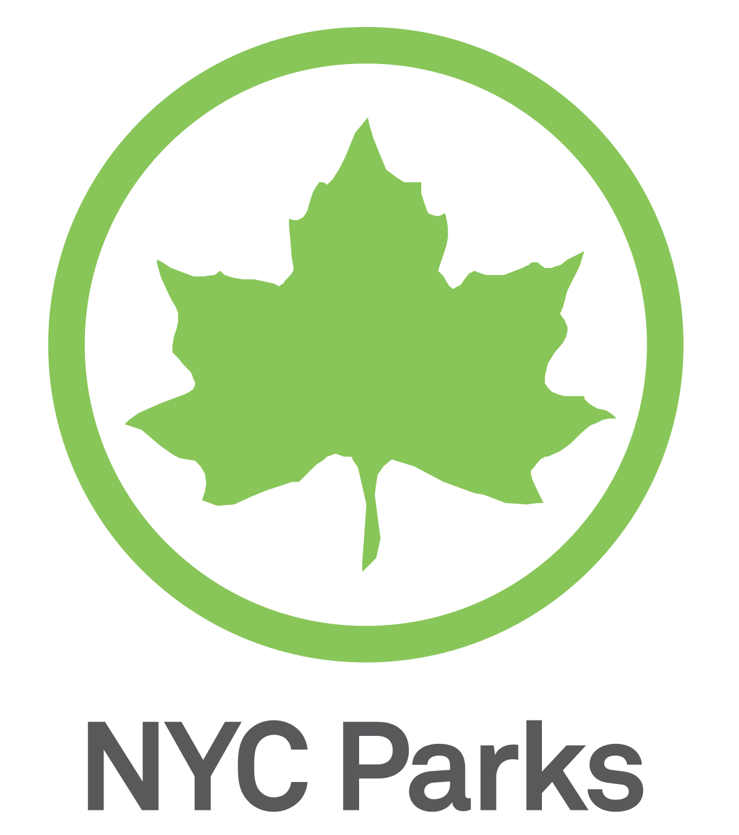
Group 4 Yunshan Shi Qingru Yang Yi Sun Shuhui Tang Le Wang Yuting Li June 29, 2021
2015 Street Tree Census Report

Slide 2
OVERVIEW
Introduction
Residents' concern
Government's concern
Conclusion

Slide 3
Introduction
The dataset contains 45 variables and 683,788 observations
We have two audiences: residents and government officials
For Residents: Which borough is the best to live in?
For government officials: Which trees should be planted more or less, which trees should be protected more?
We will go through species, sidewalk conditions, the health of all street trees in New York City to analysis.

Slide 4
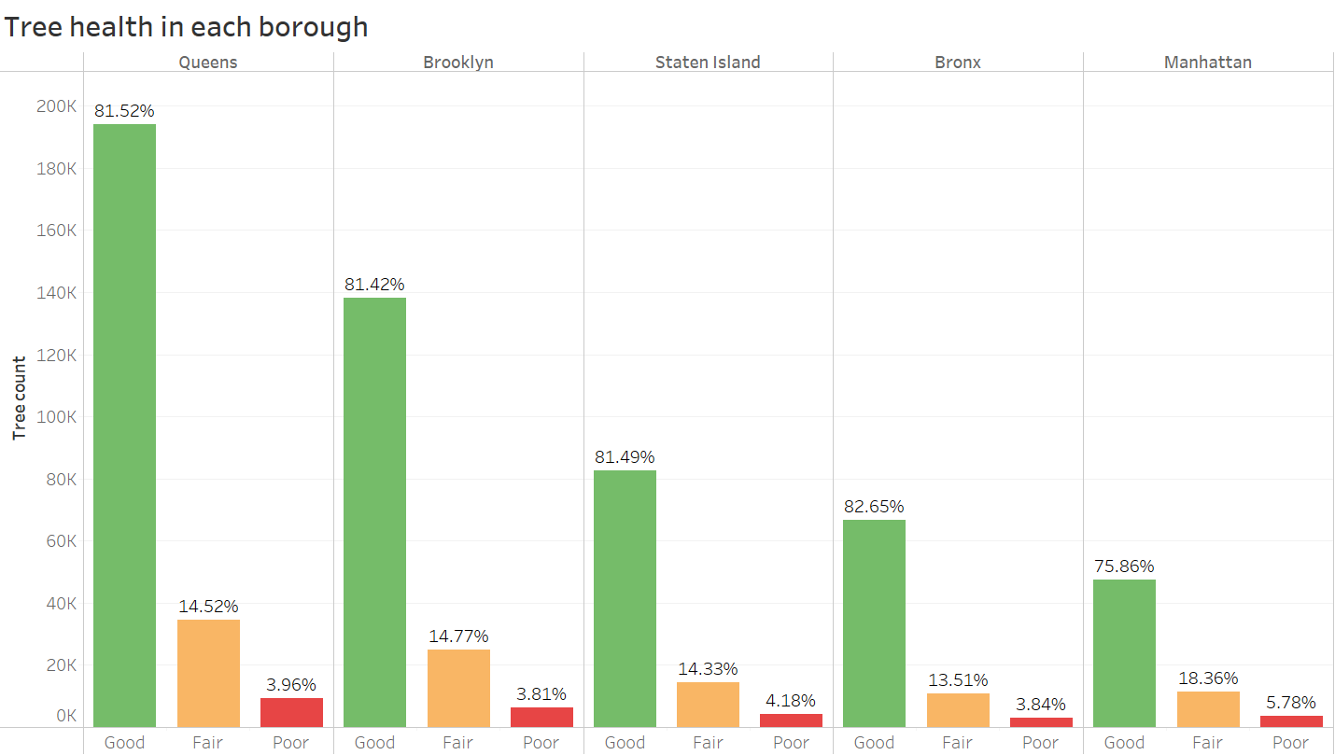
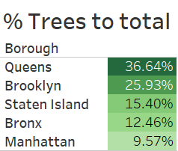

For Residents' Concern:
Queens has the most trees( 36.64% ) and a high percentage of good condition (81.52%)
Queens

Slide 5
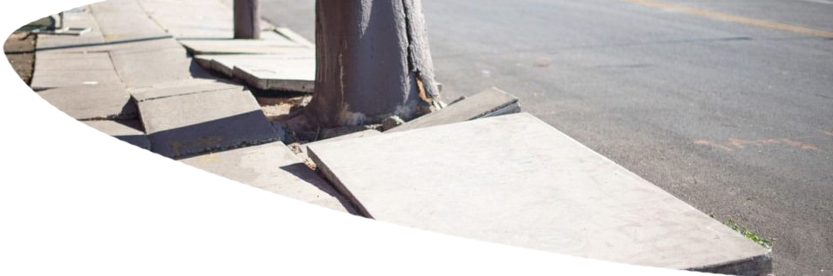
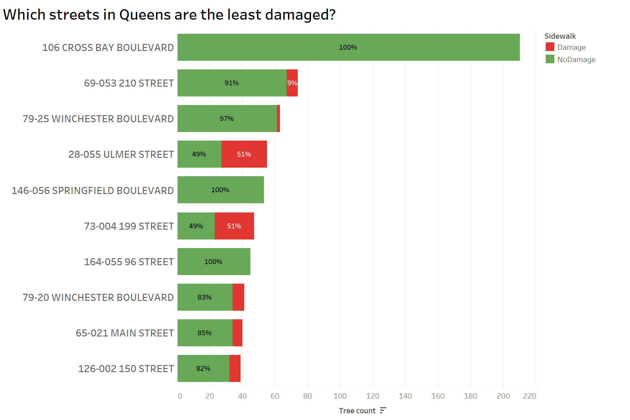
For Residents' Concern:
What else do residents care about?
The amount of trees on the street.
The condition of sidewalks (whether it is damaged or not).

Slide 6
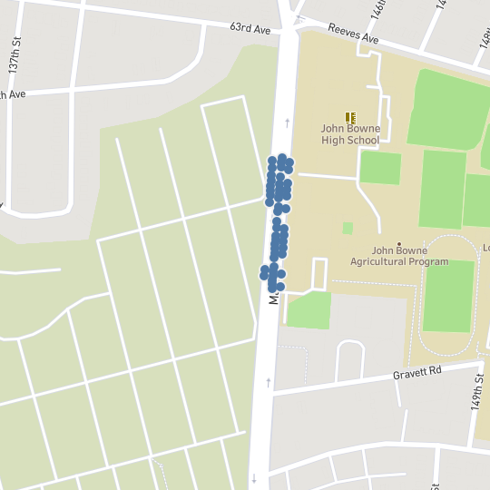
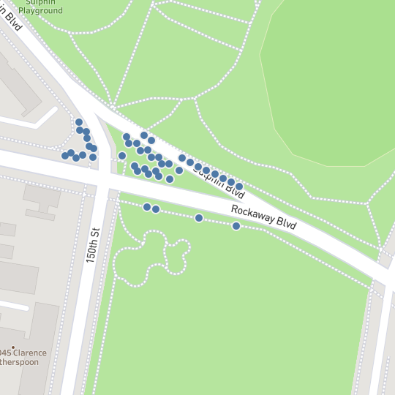
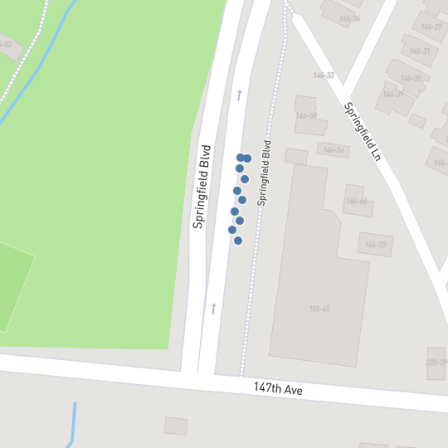
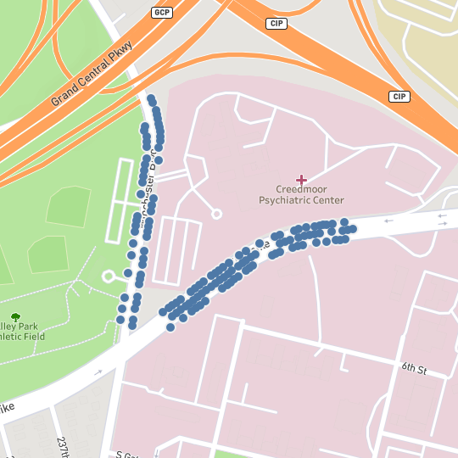
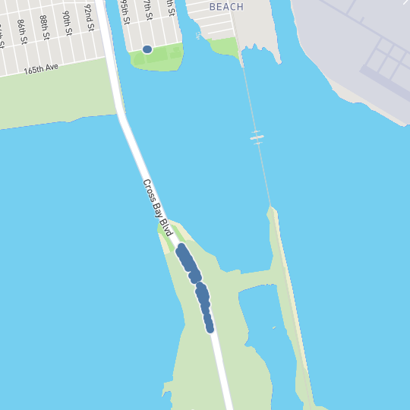
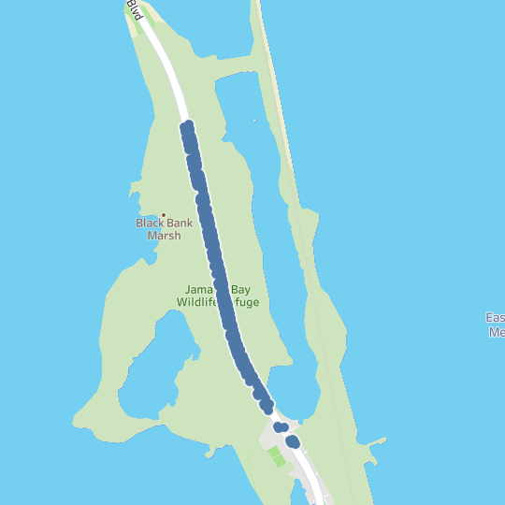
Conclusion:
There are five streets can be good choices for living:
79-20 Winchester Boulevard,
79-25 Winchester Boulevard,
69-053 210 Street,
146-056 Springfield Boulevard,
126-002 150 Street.
🏡
🏡
🏡
69-053 210 Street
126-002 150 Street
146-056 Springfield Boulevard
79-20 Winchester Boulevard
79-25 Winchester Boulevard
106 Cross bay Boulevard
164-005 96 Street
❌
🏡
❌

Slide 7
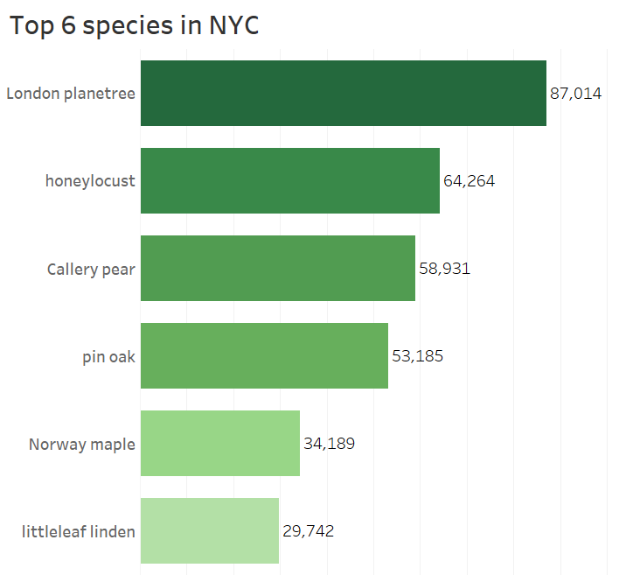
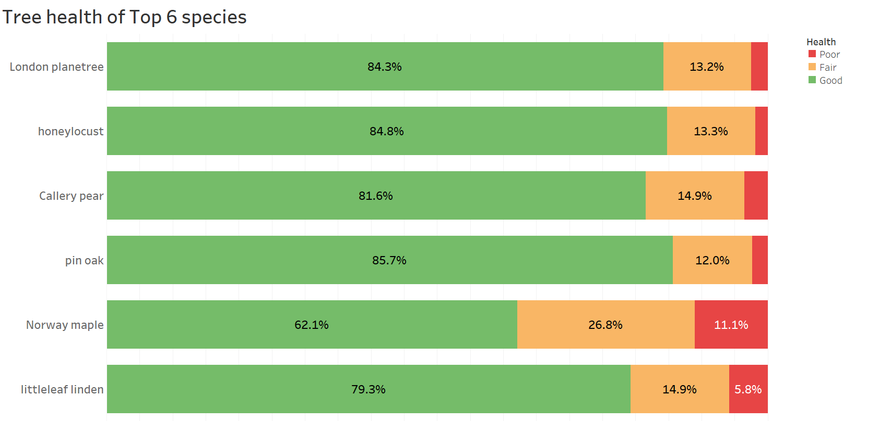
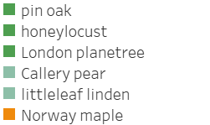
For Government's Concern:
The government may be concerned about the health condition of the most existing tree species, and should these trees be planted more or less?
Using green to mark the species with high health conditions, light green to mark the medium ones, and yellow to mark the species with the lowest health condition for further analysis.
More London planetree, Honey locust, and Pin oak should be planted.
Less Norway maple should be planted.

Slide 8
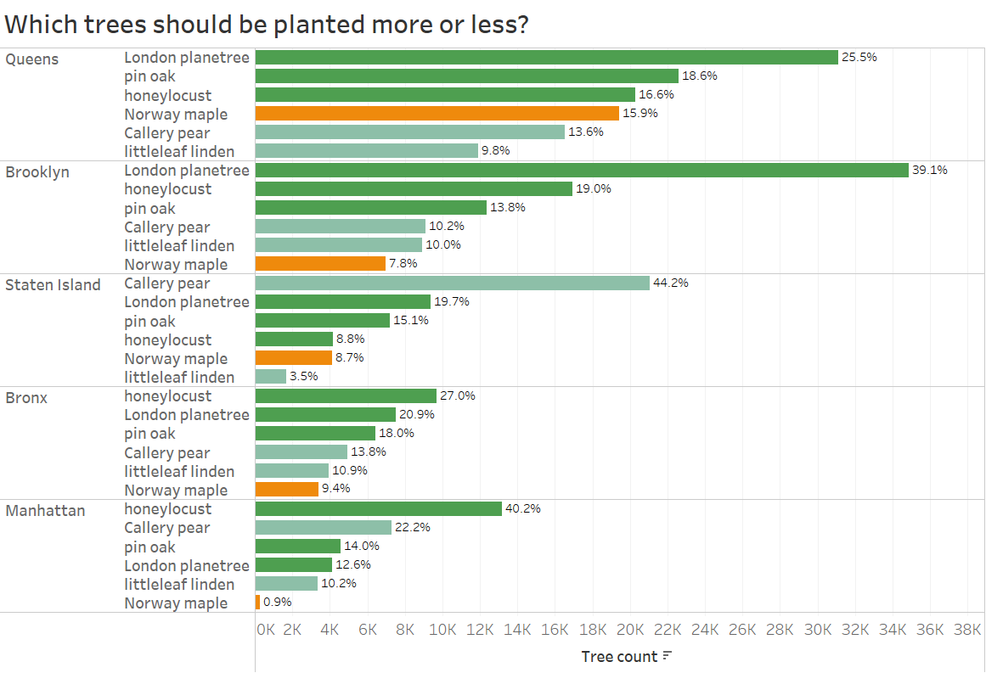
For Government's Concern:
The proportion of the top 6 trees in each borough
The Norway Maple ranked fourth place in Queens at 15.9%. But it is in the worst health condition. It should be paid more attention to protect and plant less when new trees are planted.
The Callery Pear has a 44.2% on Staten Island. Consider planting three other healthier species when planting new trees.
Manhattan, Brooklyn, and the Bronx have a healthy distribution of trees.

Slide 9
Conclusion
For residents: Which borough is the best to live in?
79-20 Winchester Boulevard, 79-25 Winchester Boulevard, 69-053 210 Street,
146-056 Springfield Boulevard, 126-002 150 Street in Queens borough
For government officials: Which tree should be planted more and less?
Plant more London planetree, Honey locust, and Pin oak, less Norway Maple in the future.
Pay more attention to protecting the existing Norway Maple trees.

Slide 10
References
Kabacoff, R. (2015). R in action: Data analysis and graphics with R. Shelter Island, NY: Manning.
Knaflic, N. C. (2019). Storytelling with Data: Let’s Practice! (1st ed.). Wiley.

Slide 11
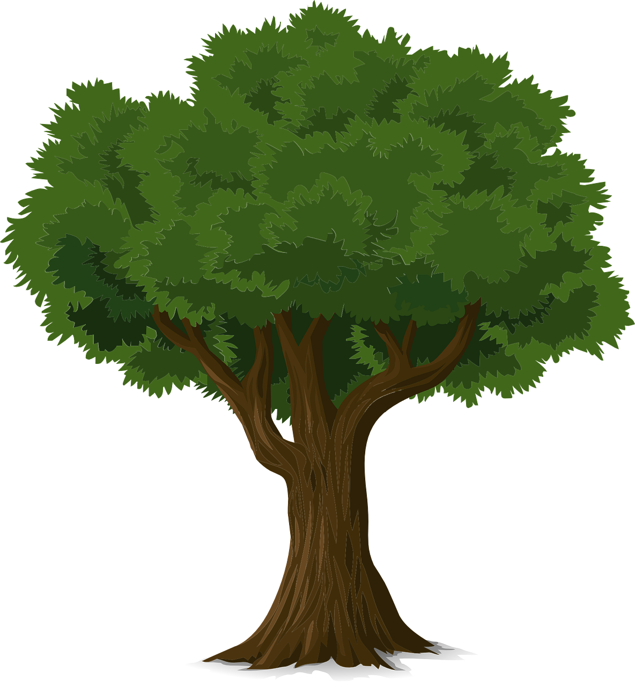
Thanks for watching !

